Slide 1
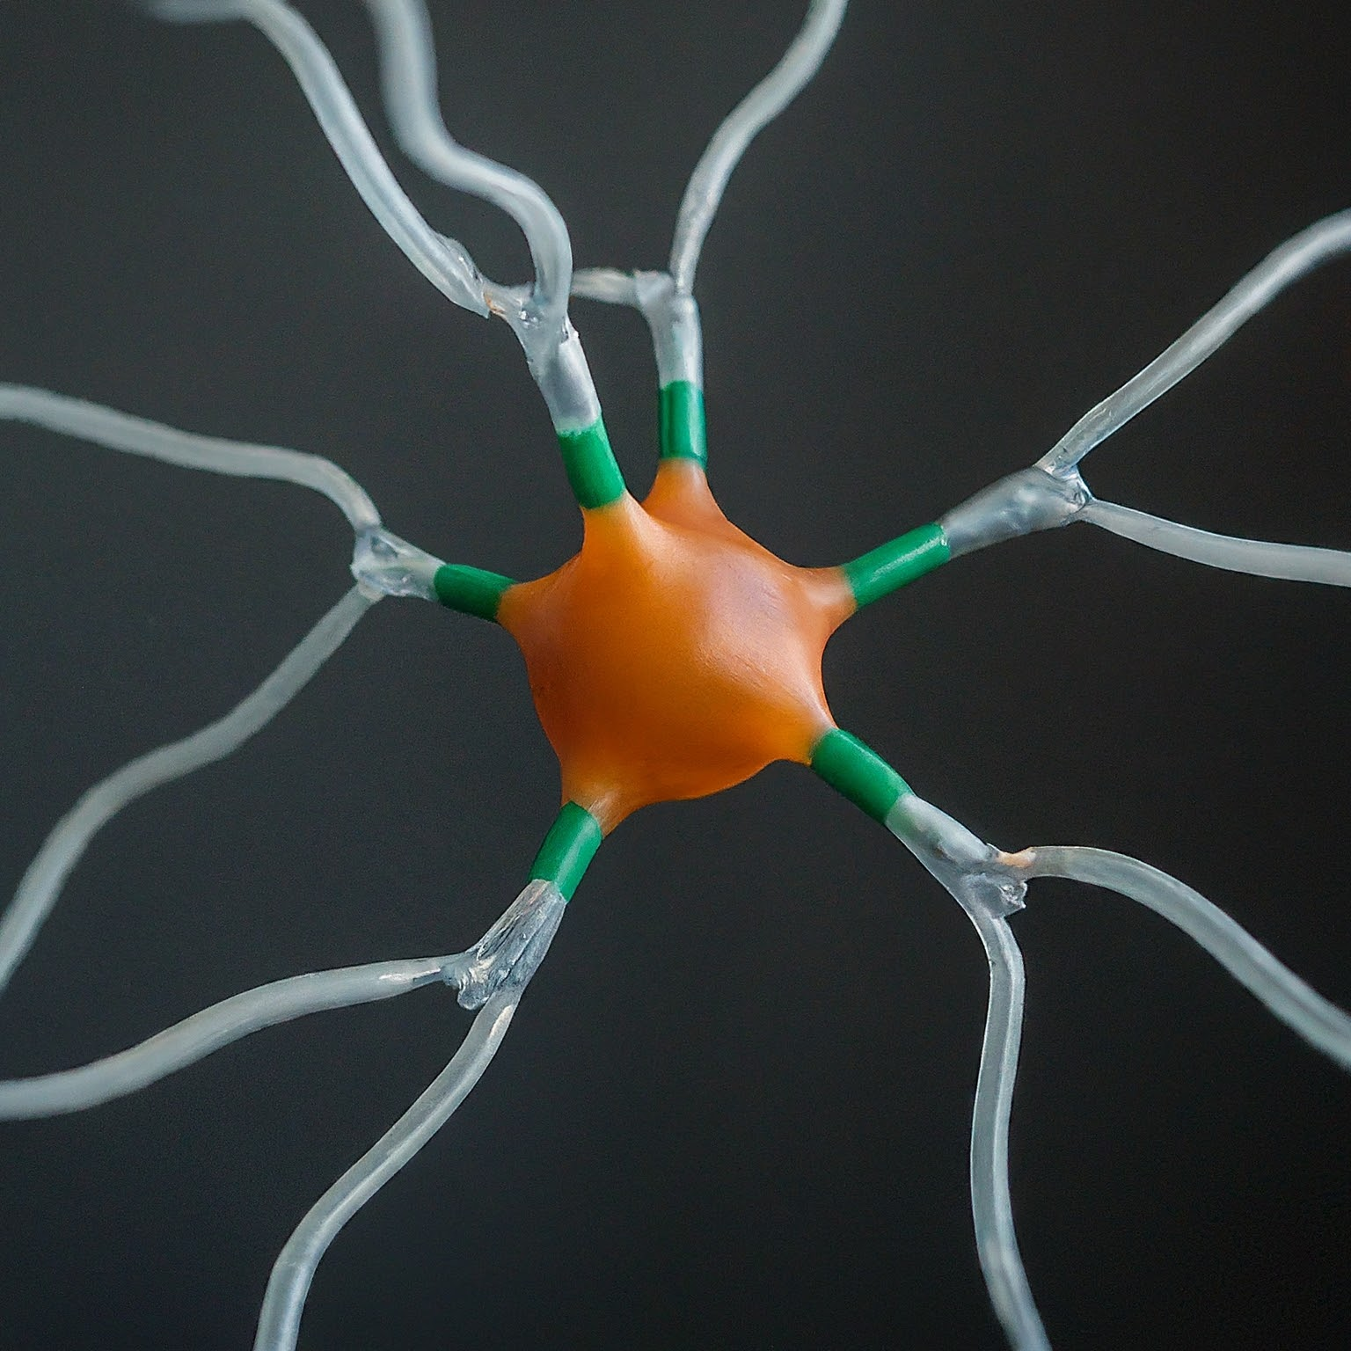
Perceptrons: The Building Block of Neural Networks
Notes:
In this presentation, we will explore the perceptron, a fundamental unit of artificial neural networks.
Perceptrons, though simple, are the building blocks for more complex neural network architectures.
We will delve into their structure, function, and limitations, laying the groundwork for understanding more advanced neural networks.

Slide 2

Introduction to Artificial Neural Networks
Artificial Neural Networks (ANNs) are inspired by the structure and function of the human brain.
They consist of interconnected processing units called artificial neurons.
ANNs are trained to learn patterns from data and make predictions.
Notes:
Artificial neural networks are a powerful tool in machine learning, mimicking the human brain's ability to learn and adapt. These networks are made up of interconnected artificial neurons, which process information and learn from data. By training these networks on vast amounts of data, they can identify patterns and make predictions for various tasks.

Slide 3
The Perceptron: A Simple Artificial Neuron
The perceptron is the simplest form of an artificial neuron.
It has one or more input nodes that receive data.
Each input is associated with a weight, determining its influence on the output.
Weighted inputs are summed and passed through an activation function to generate the final output.
Notes:
The perceptron is the fundamental unit of neural networks. It receives data through its input nodes, each having an associated weight that determines the importance of that input. These weighted inputs are summed, and an activation function is applied to determine the final output of the perceptron.

Slide 4
Learning in Perceptrons
Perceptrons learn through a supervised learning algorithm called the perceptron learning rule.
This rule adjusts the weights based on the difference between the desired output and the actual output.
The learning process continues iteratively until the perceptron achieves the desired level of accuracy.
Notes:
Perceptrons learn through a process called the perceptron learning rule. This supervised learning algorithm compares the actual output of the perceptron with the desired output and adjusts the weights of the connections to minimize the error. This iterative process continues until the perceptron can accurately classify the data it is trained on.

Slide 5
Learning Process
Supervised learning through the perceptron learning rule.
Compares desired output with the actual output.
Adjusts weights based on the difference (error) to minimize future errors.
Iterative process until the perceptron achieves desired accuracy.
Notes:
Perceptrons learn through a process called the perceptron learning rule. This supervised learning algorithm compares the actual output of the perceptron with the desired output and adjusts the weights of the connections to minimize the error. Imagine training a perceptron to classify emails as spam or not spam. The perceptron would receive features of an email (e.g., presence of certain words) and learn to adjust its weights to accurately classify emails based on training data.

Slide 6
Applications of Perceptrons
Perceptrons are well-suited for simple linear classification tasks.
Data can be perfectly separated by a straight line.
Examples include:
Spam filtering (classifying emails as spam or not spam)
Image recognition (identifying basic shapes)
Linear regression (predicting continuous values)
Notes:
Perceptrons excel at solving problems with linearly separable data, where a straight line can perfectly divide the data into two categories. Applications include spam filtering, where emails are classified as spam or not spam, and basic image recognition tasks like identifying shapes. However, perceptrons struggle with non-linear data, limiting their applications in complex scenarios.

Slide 7
Limitations of Perceptrons
Perceptrons can only solve linearly separable problems.
They cannot handle complex, non-linear relationships in data.
This limitation restricts their use in many real-world applications.
Notes:
A significant limitation of perceptrons is their inability to solve problems with non-linearly separable data. Imagine classifying data points scattered in a circle and a crescent shape. No straight line can perfectly separate these two classes. This limitation restricts perceptrons to simpler tasks and necessitates the development of more advanced neural network architectures like multi-layer perceptrons (MLPs) to handle complex real-world

Slide 8
Structure of a Perceptron:
Input nodes: Receive data (e.g., pixel values from an image).
Weights: Associated with each input, determining its influence on the output.
Bias unit: Constant value added to the weighted sum of inputs, adjusting the overall output.
Activation function: Transforms the weighted sum and bias into a final output.
Notes:
The perceptron is the fundamental unit of neural networks. It receives data through its input nodes, each having an associated weight that determines the importance of that input. These weighted inputs are summed along with a bias unit, and an activation function is applied to determine the final output of the perceptron.

Slide 9

Perceptron Model
Formula:
Output (y) = f(Σ(w_i * x_i) + b)
Where:
Σ represents the summation over all n inputs.
w_i is the weight for the i-th input.
x_i is the value of the i-th input.
b is the bias term.
f( ) is the activation function.
Inputs : x.
Parameters : w
y = 1 if $w^{t}x ≥0$
= 0 otherwise
An example of a binary linear classifier.
Binary : Two possible classification decisions (0 or 1).
Linear: $w^{t}x ≥0$

Slide 10
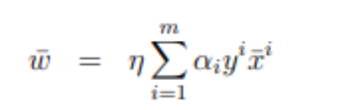
Weighted Sum equation.
𝑤ˉ: This represents the weight vector that defines the decision boundary in the feature space.
𝜂: This is a scaling factor or learning rate, used to adjust the influence of each term in the summation.
∑𝑖=1𝑚: This indicates a summation over all training examples, from 𝑖=1i=1 to 𝑖=𝑚i=m.
𝛼i​: These are the Lagrange multipliers associated with each training example. They are non-negative and represent the contribution of each training example to the decision boundary.
𝑦𝑖: This represents the class label of the 𝑖i-th training example. Typically, 𝑦𝑖∈{−1,1}yi∈{−1,1} for binary classification problems.
𝑥ˉ𝑖: This denotes the feature vector of the 𝑖-th training example.

Slide 11
Question 1: Perceptron example
This table shows a dataset and how many times each data point was classified incorrectly by the perceptron algorithm. The perceptron started with zero weights for all inputs.
Given the information in the table:
The data points themselves (represented by x1, x2).
The number of times each data point was misclassified (indicating how well it's separated by the line).
Assuming the perceptron learning algorithm was used with the following settings:
Learning rate: 1 (This determines how much the weights are adjusted based on errors).
Initial weights: All zeros (This means the perceptron started with no bias towards any particular classification).
Can you tell me the equation of the decision boundary (separating line) that the algorithm learned?

Slide 12
Question 1: Example
x1 | x2 | Y | Times misclassified
4 | 1 | 1 | 8
5 | 3 | 1 | 4
1 | 2 | 0 | 5
SUM =
(8 )(1) ( 4, 1, 1) + (4 )(1) ( 5, 3, 1) + (5 )(0) ( 1, 2, 1)
(32, 8 , 8) + (20, 12, 4) + (0, 0 ,0)
(52, 20, 12)
52x1 + 20x2 + 12 = 0
X1 = 8 * 1 * 4 + 4*1* 5 + 5*0 *1
= 52
X2 = 8 * 1* 1 + 4*1* 3 + 5*0*2
= 20
= 8*1*1 + 4*1*1 + 5*0*1
= 12
52x1 + 20x2 + 12 = 0

Slide 13
Question 1: Perceptron example
Suppose we have the following data points, and no bias term:
x = (1, −2),t = 1
x = (0, −1),t = 0
The initial weight vector is (0, −2).
Draw the feasible regions in weight space.
Draw the axes in weight space w1,w2.
Draw each data point as a line that separates “good” and “bad” regions.
Shade the feasible region.
Carry out the perceptron algorithm until you get a feasible solution. It’s easiest to do it on the plot you made.
Here is the algorithm - Choose a data point x with target t Compute y = 1 if wT x ≥ 0 0 otherwise If y 6= t, then update w ← w + (t − y)x

